Slide 1
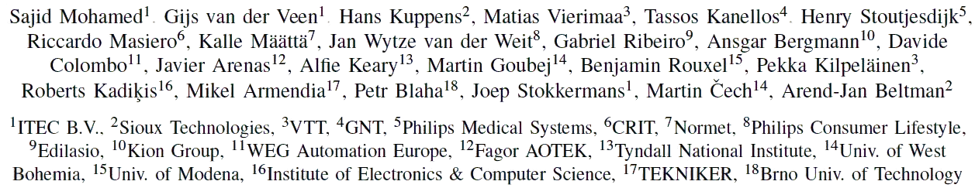
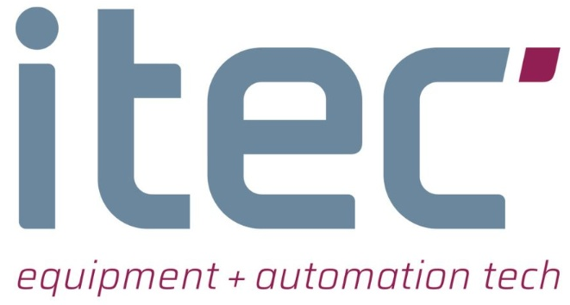
The IMOCO4.E reference framework for intelligent motion control systems
Sajid Mohamed, sajid.mohamed@itecequipment.com
ETFA 2023
12 September, Sinaia, Romania

Slide 2
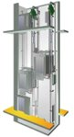
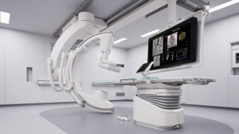
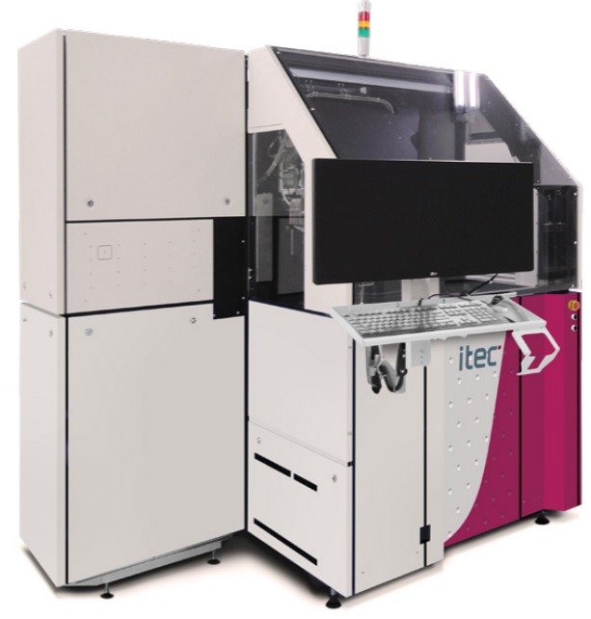
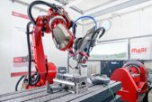
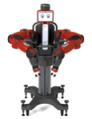
Intelligent motion control systems
Challenge
Smart integration of intelligent motion control systems with commercial and industrial systems
Critical in modern industrial environments that require precise and complex motion control
Integrates smart sensors, intelligent algorithms, novel computing platforms and smart actuators*
Smart, Intelligent – using AI
Prominent in many industrial domains
Smart Sensor
Intelligent algorithms
)
Smart Actuator
)
)
Computing Platform
*Sajid Mohamed, “D2.3 Overall requirement on IMOCO4.E reference framework,” Zenodo, 2022.
Notes:
First, A brief background on intelligent motion control systems.
Critical in modern industrial environments requiring precise and complex motion control.
They integrate smart sensors, intelligent algorithms, smart actuators and computing platform.

Slide 3
Challenge of smart integration
Complex task requiring
significant domain expertise
industrial ‘know-how’ of processes
resilient adaptation for various engineering phases
Advancements in AI, big data and digital twin approaches amplify this challenge
Increased complexity
Necessity to integrate these novel approaches with brownfield systems
A standardized integration approach considering novel methods lacking
Challenging for start-ups, SMEs and academic partners to develop commercial platforms seamlessly integrating with brownfield systems

Slide 4
Proposed solution
The IMOCO4.E reference framework
a generic platform for
designing,
developing, and
implementing
novice and complex motion-controlled industrial systems
refinements and instantiations for different IMOCO4.E industrial cases are also provided

Slide 5
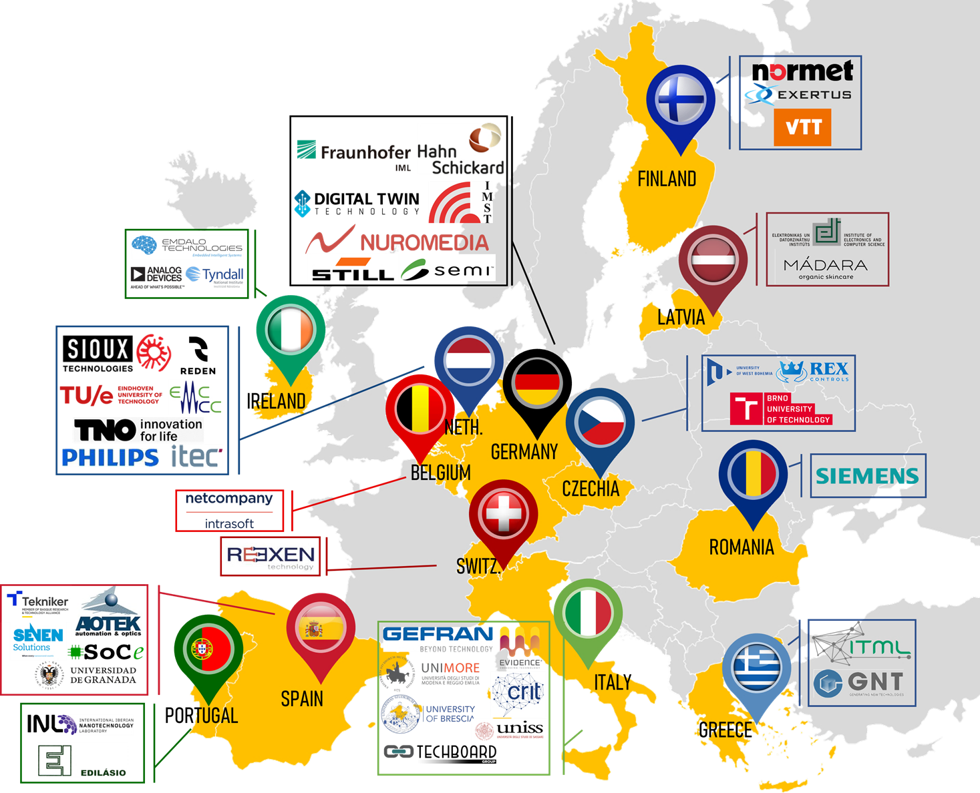


IMOCO4.E General Info
Acronym: IMOCO4.E
Full name: Intelligent Motion Control under Industry4.E
Coordinator: Sioux Technologies B.V.
GA No.: 101007311 - H2020-ECSEL-2020-RIA
Start date: 1st September 2021
Duration: 36 months
Consortium: 46 Partners from 13 countries
~31 M€ Total Costs
👨‍💼
Project Leader: Mr. Arend-Jan Beltman
✉
Arend-Jan.Beltman@sioux.eu
🌐
www.imoco4e.eu
Connect and find more here:
@IMOCO4E
@IMOCO4E

Slide 6

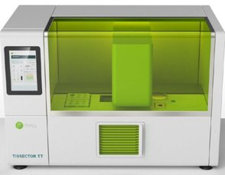
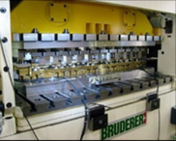

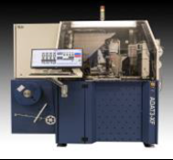

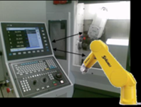
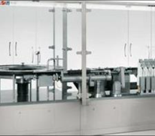
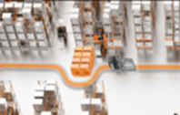
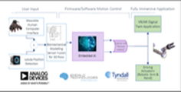
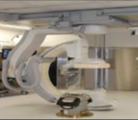
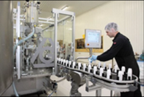
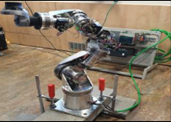
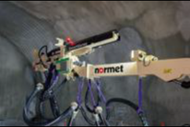
The 13 IMOCO4.E Cases
Pilots
Demonstrators
Use Cases
Pilot 1: Tissector
Lead: Sioux, NL
Demo 1: Shaver blades
Lead: Philips Consumer Lifestyle, NL
Use case 1: Industrial drive for smart mechatronics applications
Lead: Gefran, IT
Pilot 2: Semiconductor production
Lead: ITEC B.V., NL
Use case 2: CNC for integrated machine
tool and robot control
Lead: Fagor Aotek, ES, and Tekniker, ES.
Demo 2: Plastic molding
Lead: Edilásio, PT
Pilot 3: High speed packaging
Lead: CRIT, IT
Demo 3: Warehouse logistics
Lead: Still, DE
Use case 3: Tactile Robot Teleoperation
Lead: Tyndall National Institute, IE
Pilot 4: Healthcare robotics
Lead: Philips Medical Systems, NL
Demo 4: Cosmetics production
Lead: Madara Cosmetics, LV
Use case 4: Advanced and Intuitive
robot control and programming control
Lead: University of West Bohemia, CZ
Pilot 5: Mining/tunneling robotic boom
Manipulator Lead: Normet, FI
Pilots | Applications defined at the machine level
Demonstrators | Applications defined at the industrial production-line level
Use Cases | Partial applications on commercial productions of motion control ecosystem

Slide 7
The benefits (some of the expected results per case)
10%
30%
Reduction of accidents in Warehouse logistics (Demo 3)
60%
50%
20-40%
Reduction of material consumption (Pilot 5)
Reduction of the length of the control loop (Demo 4)
Testing time reduction by using Digital Twins (Pilot 5)
Reduction of time-to-market (Pilot 4)
5%
95%
50%
10%
10%
Reduction of commissioning service/time of new modules to market
(All Pilots)
Energy consumption reduction by optimizing machine performance (Demo 3)
(Demo 3)
Increased number of productive hours/day
(Pilot 4)
Increase of machine speed/ production rate (Pilot 2, 3)
Increased resource utilisation and reduction of waste (Pilot 3)
September 11, 2023
7

Slide 8
Methodology
Identifying shortcomings from the state-of-the-art reference architectures ^{[1]}
Identifying the needs for future smart production from the mechatronics and robotic point-of-view ^{[2]}
Gathering and characterizing the brownfield architectures of the industrial cases from IMOCO4.E consortium
First iteration of the requirements ^{[3]} and specifications of the IMOCO4.E concepts – layers, BBs, P/D/UCs
Adhere to the guidelines of IMOCO4.E methodology ^{[4]} and toolchains
Gathering and characterizing the greenfield reference architectures from industrial partners
[1] Hans Kuppens, “D2.1 State-of-the-art methods in Digital Twinning for motion-driven high-tech applications,” Zenodo, 2021.
[2] Matias Vierimaa, “D2.2 Needs for future smart production in Europe from the mechatronics and robotic point of view,” Zenodo, 2022.
[3] Sajid Mohamed, “D2.3 Overall requirements on IMOCO4.E reference framework,” Zenodo, 2022.
[4] Hans Kuppens, “D6.1 Guideline of IMOCO4.E methodology and toolchains,” Zenodo, 2022.

Slide 9
The IMOCO4.E reference framework

Slide 10
The IMOCO4.E reference framework
Overview
Architecture viewpoint
Data management viewpoint
A brief section on model management
AI viewpoint
Digital twin viewpoint
Refinements for P/D/UCs
From all 13 industrial cases

Slide 11


SAP/ERP/MES/SCADA
Architecture viewpoint
Layer 4: digital twin and
AI analytics
Data storage
Digital twin platform
AI analytics platform
Digital Twin Aggregation
(DTA)
AI Analytics Aggregation
Monitor UI
Digital object space
Server (IT) infrastructure
Digital object
Comparitor
(Re)Trained network
Labelling
Synthetic/ Augmented Data
Cyber-security
System administration
Message broker
Data ingestion
Persistent storage
Digital object adapter
Decider
(Re)
Training
Dataset
Interfaces
Communication interfaces
…
Machine 1
Machine-of-Interest
Machine n
Layer 3: system behaviour
Predictive maintenance
Status monitoring
Diagnostics
Central platform
Process control
Tuning
Feedforward control
Behaviour
Behaviour
Interfaces
Layer 2: (de)centralized controllers
Control
Predictive maintenance
Monitoring
Motion control platform(s)
Control
Motion control platform(s)
Feedback control
Motion control platform(s)
Interfaces
Real-time communication interface(s)
Interfaces
Layer 1: sensors/actuators
Smart I/O
Sensors
Edge platform(s)
Actuators
Smart I/O
Monitoring
SW + HW
Edge processing

Slide 12
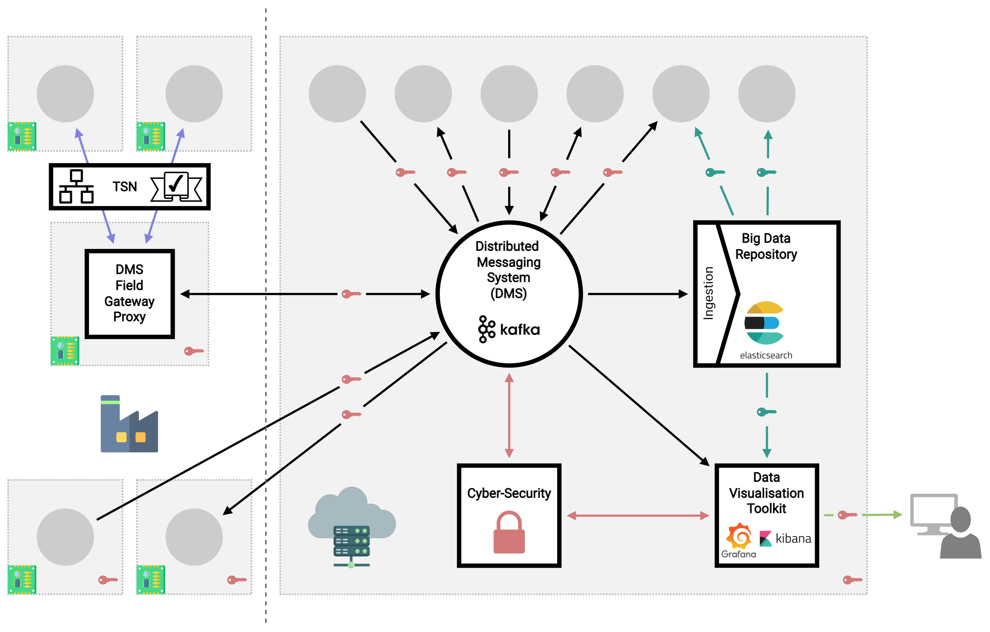
Data management viewpoint

Slide 13




Layer 4: digital twin and
AI analytics
BB8
AI analytics instance from other machines/systems
BB9
AI analytics aggregation
Cyber-security
Data visualisation
Instance data from other machines/systems
AI analytics and training instance
Data
Big Data Repository
Synthetic/ Augmented Data
Data ingestion
Distributed Messaging System (DMS)
(Re)
Training
Layer 3: system behaviour
Dataset
BB5: control configuration & diagnosis
BB10: Motion/ Path planning, collision avoidance & navigation
BB6: Algorithms for condition monitoring, predictive maintenance and self commission
Labelling
Central platform
Field Gateway Proxy
(Re)Trained
Network
TSN platform
Layer 2: (de)centralized controllers
Infrastructure
BB4: Real-time platform
BB5: smart control algorithms
Deploy
Motion control platform(s)
Tools
BB2: High speed vision-in-the-loop
BB1: SoC/ FPGA platforms
Layer 1: sensors/actuators
Deployment
BB3: Novel sensors
BB7: High speed servo drives
Other sensors/ actuators/ platforms
Deploy
trained network
Deploy
Notes:
A distinction is made between 1. Hardware, 2. Software and 3. platforms (hw + sw + comm)

Slide 14
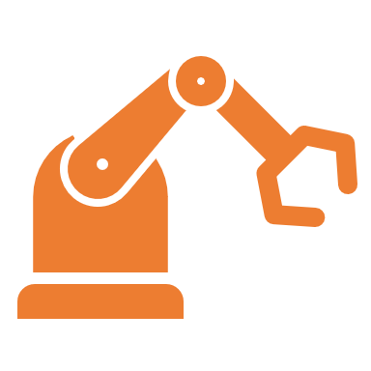

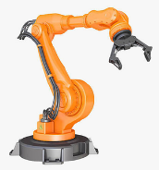
AI platform
Design
Manufacturing
Services
AI modelling and training
AI inference optimization
AI analytics and services
Deployment
Deployment
Process optimisation
Data
Retire
AI Instance
Next
cycle
Sensing
Sensing
Monitoring
Machine prototype
Assembled machine
Machine operation
Physical entity

Slide 15
Layer 4: digital twin and
AI analytics
AI analytics instance from other machines/systems
DT platform
Instance data from other machines/systems
Digital twin instances of other machines
Digital twin aggregation
BB8
BB9
AI analytics aggregation
Cyber-security
Data Visualisation
Digital twin instance
Digital object
Comparitor
AI analytics and training instance
Big Data Repository
Data
Digital object adapter
Data ingestion
Synthetic/ Augmented Data
Decider
Distributed Messaging System (DMS)
Layer 3: system behaviour
(Re)
Training
BB5: control configuration & diagnosis
BB10: Motion/ Path planning, collision avoidance & navigation
BB6: Algorithms for condition monitoring, predictive maintenance and self commission
Dataset
Labelling
Field Gateway Proxy
Central platform
(Re)Trained
Network
TSN platform
Layer 2: (de)centralized controllers
BB4: Real-time platform
BB5: smart control algorithms
Infrastructure
BB1: SoC/ FPGA platforms
BB2: High speed vision-in-the-loop
Motion control platform(s)
Tools
Layer 1: sensors/actuators
BB3: Novel sensors
BB7: High speed servo drives
Other sensors/ actuators/ platforms
Deployment
Notes:
A distinction is made between 1. Hardware, 2. Software and 3. platforms (hw + sw + comm)

Slide 16
DT platform
Design
Manufacturing
Services
Digital twin virtual models
Digital twin prototype
Digital twin instance
Parameters
Control
Optimisation
Predictive maintenance
Data
Retire
Digital Twin Instance
Next
cycle
Specifications
Sensing
Monitoring
Machine prototype
Assembled machine
Machine operation
Physical entity

Slide 17
Example refinements

Slide 18
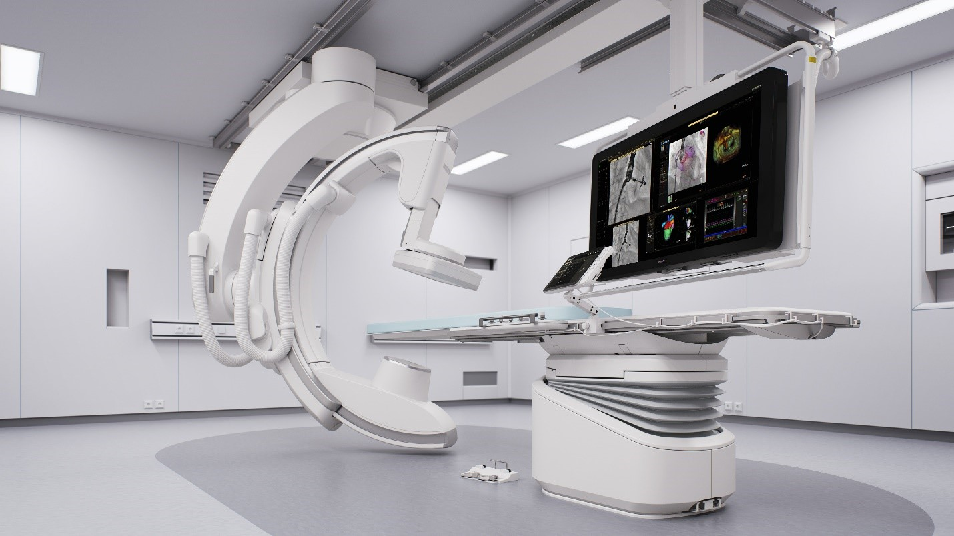
Pilot 4 – Philips Medical Systems
Healthcare robotics

Slide 19
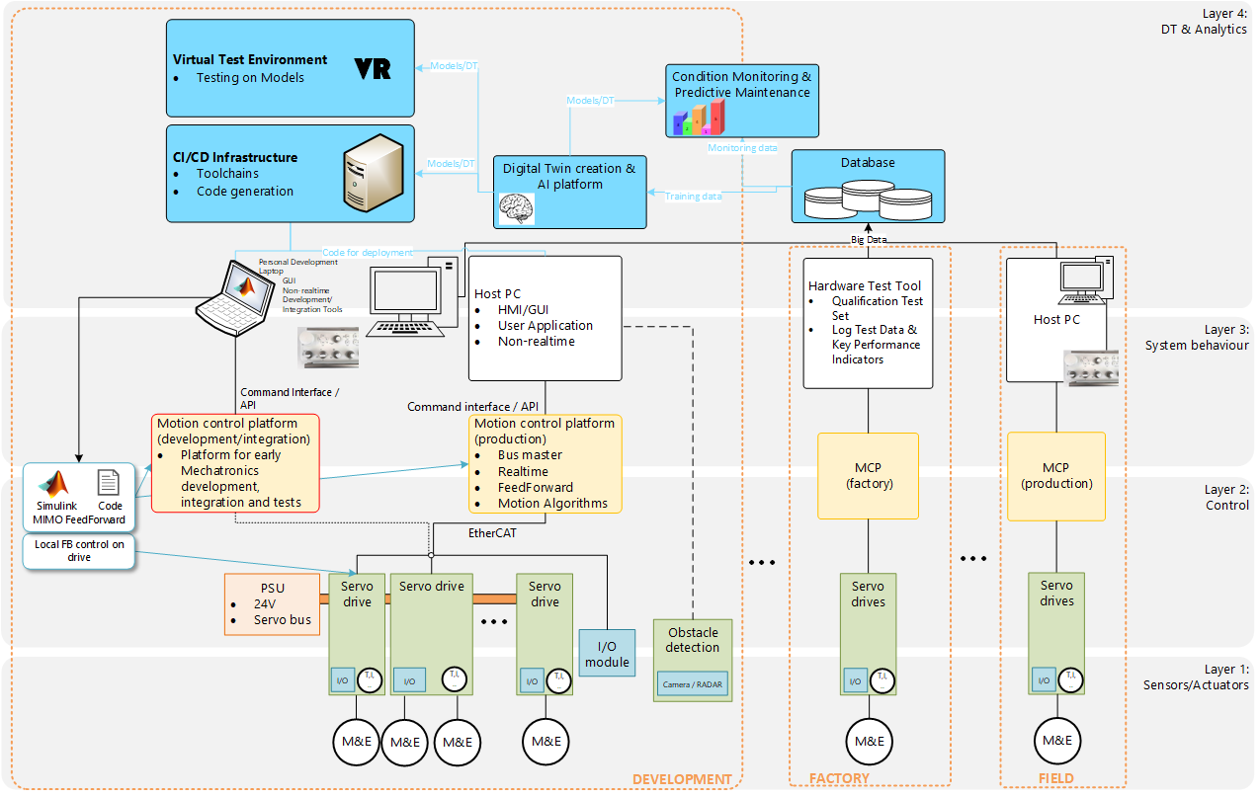

Slide 20
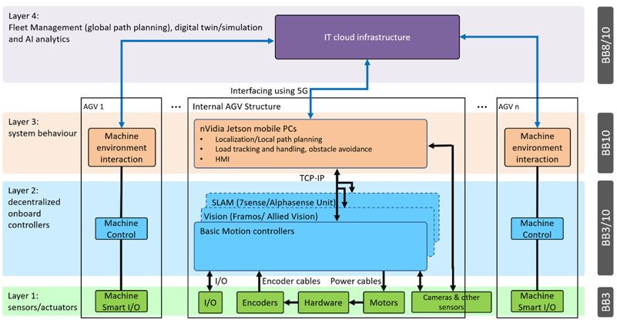
Demonstrator 3

Slide 21
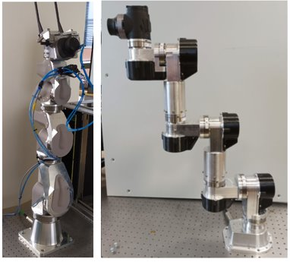
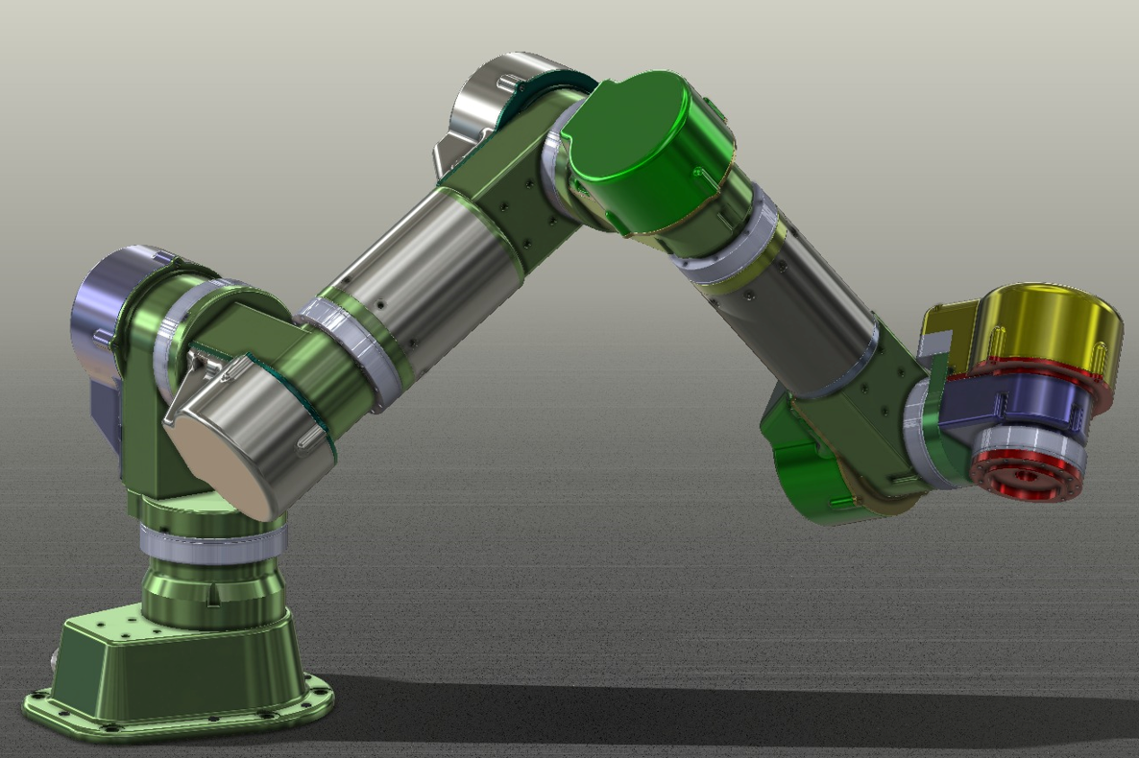
Use case 4 – collaborative robotic platform
Layer 4
Monitor, Maintenance & drive commissioning system
BB6
Cloud Server
TCP/IP
Data Storage
TCP/IP – REST/MQTT/OPC UA
Machine 1
COLLABORATIVE ROBOTIC PLATFORM
…
Machine n
Machine Behaviour
Industrial PC (IPC)
Industrial Router
Machine Behaviour
BB5
EtherCAT
Machine Control
7x AMC2 servo controllers
Machine Control
AMC2 controller
Low-level drive control (torque/velocity/position loop)
Controls robot motors and brakes
Interfaces for I/Os (e.g. inertial or force/torque sensors)
BB7
I/O
Encoder cables
Power cables
Machine Smart I/O
I/O
Encoders
Hardware
Motor
Brake
Machine Smart I/O

Slide 22
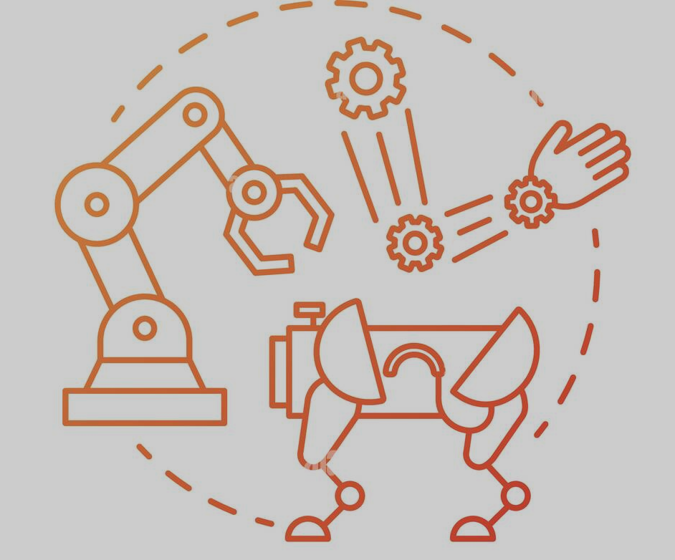
Conclusion
IMOCO4.E Reference Framework for edge-to-cloud intelligence
A framework for smart integration of intelligent motion control systems with commercial and industrial systems
Intelligent motion control systems will be:
01
SMARTER
FASTER
02
Highly configurable
06
RESILIENT
03
HIGHLY RELIABLE
HIGHLY ACCURATE
05
04
September 11, 2023
22

Slide 23



Thank you! Questions?
Connect with us:
Find more:
www.imoco4e.eu
@IMOCO4E
@IMOCO4E

